Slide 1
Managing Our Energy:
[Your Facility Logo Goes Here]
Staying Energy Smart!
NORTHWEST ENERGY EFFICIENCY ALLIANCE
Notes:
Instructions
Add your facility’s logo in the center circle.
Talking points
Welcome.
We all know that energy is becoming a bigger issue every day.
We want to take some time today to recognize what we’ve been doing right and look at how we can work together to achieve even more this coming year.

Slide 2
Energy Is a Top Priority
Production
Quality
Safety
Energy
[Insert facility photo here]
Notes:
Talking Points
Energy is just as important to our work as safety and quality.
Just as we have programs to help us improve our safety and quality, we also have our Continuous Energy Improvement program in place to help us manage energy usage.
We’re all working hard to manage energy as we do our jobs.
When we think about our priorities, we need to make sure that energy is top-of-mind.

Slide 3
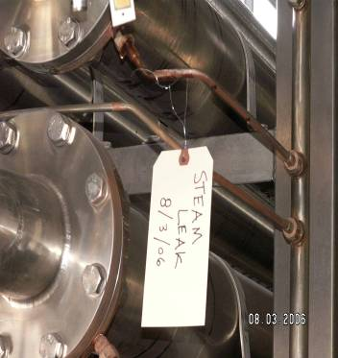
Why Is Energy a Priority?
Managing energy helps us:
Reduce product cost
Improve facility efficiency
Stay competitive
Area for picture
Notes:
Instructions: NOTE SPECIAL FORMAT
There are three invisible bullets on this slide.
The first time you hit the advance key, or click your mouse, the first bullet will appear.
When you hit the advance key again, or click your mouse again, the next bullet will appear.
Use the animation function to reveal each bullet, once you’ve given the attendees some time to try and answer the question.
Talking Points:
Historically, energy has been cheap in the Northwest and so people rarely worried about it.
Today, energy prices are rising unpredictably, which has a greater effect on our bottom line.
Therefore, it is important to understand and manage our energy costs.
We have started to manage our energy and costs through Continuous Energy Improvement, or our CEI program.
Has managing energy really helped us?
We’ll take a look at some improvements.
Hand out prizes for strong answers and participation.

Slide 4
Thank You, Energy Team!
[Insert names and titles/roles of energy management team here]
[Insert energy management team photo here]
Notes:
Instructions
Add the names, roles, and pictures of your energy management team members.
Talking Points:
Everyone here does their part to help us save energy and save money.
We’re very lucky here at [Facility Name] to have a fantastic energy management team.
I want to make sure we all know who the team is…
Can our energy team please join me up here?
Let’s give a round of applause for their extra efforts.

Slide 5
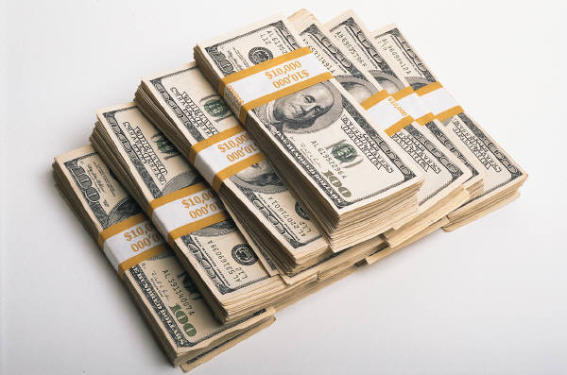
We’re Making Great Progress!
Q: How much energy and money did we save this year?
A:[XX KWH AND $XX!]
Notes:
Instructions: NOTE SPECIAL FORMAT
Reveal only the question, at first. See if you can get attendees to guess the total annual dollar savings. If no one guesses right, reveal the savings.
Talking Points:
Back in [mm/yyyy], we performed an energy self audit at our facility.
That assessment gave us a clear picture of where we could improve and where we were doing well.
It also gave us the chance to set a baseline so that we could measure our progress every year.
I’m proud to share with you all that in the past year, we saved [XX] kWH and [XX] dollars thanks to everyone’s commitment to looking for ways to save energy.
It also started us on our journey of continuous energy improvement…

Slide 6
Highlights From The Past Year
What did we learn this past year?
Which energy projects were most successful?
Where have we improved? Which areas have we made progress in?
How is CEI helping us achieve our numbers?
Notes:
Instructions:
Work with your energy team to prepare ideas for answers that you can use in your talking points.
Talking Points:
Some prompts/answers could include:
Employee ownership and awareness drive energy savings.

Slide 7
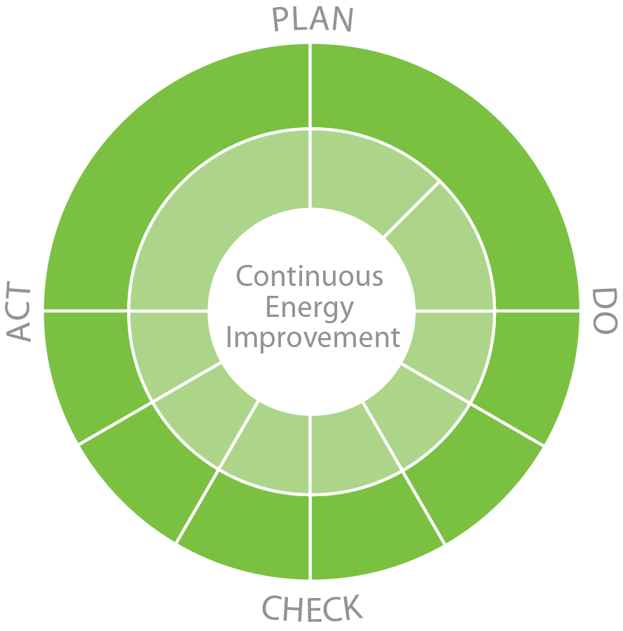
CEI Benefits So Far
Organizational Structure
Integrating energy into daily work has been possible because of leadership priority.
People
Knowledgeable, motivated employees delivered energy efficiency savings from the bottom up.
Measurement
The ability to understand and track our energy consumption allowed us to control and improve performance and savings.
Manufacturing Systems
Our comprehensive plan to manage energy included behavior change in O & M as well as successful capital investments.
Notes:
Instructions: NOTE SPECIAL FORMAT:
Click your mouse or hit the next key to play the animation built into the slide. Before presenting, add specific examples of success in each area to this notes section. Review that CEI operates across Organizational Structure, People, Manufacturing Systems, and Measurement. Ask for additional audience suggestions and examples as to how your facility is making progress in each area before sharing what you’ve written down.
Talking Points:
First, let’s take a look at our Organizational Structure. This facility’s leadership is committed to managing energy and being efficient and will keep trying to support our efforts by allocating time and resources as it makes sense.
Next, let’s look at People. Who can give me an example of how our knowledgeable employees are contributing to energy efficiency?
Prompts could include:
What about employee training?
Other ways folks are getting involved?
Now let’s take a look at Manufacturing Systems. We’re talking here about our equipment and how we interact with it, right? So what steps are people taking to make our systems more efficient?
Prompts could include:
Any repair or tag programs we could add to the list?
Any upgrade projects to share?
Moving on, let’s take a look at Measurement. How are we keeping track of our improvements?
Prompts could include:
Can anyone name a Key Performance Indicator?

Slide 8
How CEI Works For Us
CEI is a strategic energy management process. We’re implementing it here because:
CEI helps us manage energy as a controllable expense.
CEI gets all of us working together to reduce energy use.
CEI improves our energy productivity.
CEI increases payback on energy-related capital improvements.
CEI reduces O&M expenses.
CEI gives us a competitive advantage at the point of production.
Notes:
Talking Points:
Most of you are familiar with our continuous energy improvement process, CEI.
I want you to keep in mind that it really is a process, and we’ll be better at it in a year than we are now, just like we are better at thinking about and acting on energy efficiency than we were a year ago.
Let’s review the ways CEI helps us be a better, more productive and more competitive facility.

Slide 9
[Insert Facility Name] [Year] Goals
Training
Key Performance Indicators
Savings!
Notes:
Talking Points:
Now that we know how great a job we’ve been doing, we can take a look at how much better we want to be in a year.
We’re looking at a few different goals…
Training
We want to ensure staff have knowledge necessary to operate systems efficiently, and to identify inefficiency where it occurs.
What technical skills can we improve – specifically in energy efficiency?
Key Performance Indicators
We want to track metrics to ensure we are running efficiently:
Daily kWh and therms per unit
Monthly BTU/per unit (used for energy goal)
We’re developing others where applicable.

Slide 10
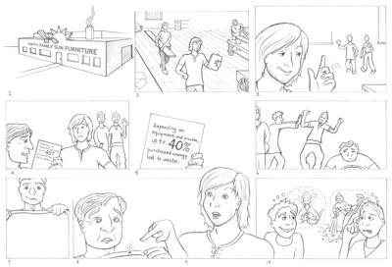
Tools We Use
Notes:
Talking Points:
We’ll continue to use a number of tools to help us reach our goal.
We have some great learning tools, such as these toolbox talk cards.
We have educational materials to remind us of how every system in our facility uses – and can more efficiently use – energy.
We have [INSERT FACILITY-PRODUCED MATERIALS, WHICH MAY INCLUDE NEWSLETTERS, TRAINING POSTERS, ETC.]
And, we have each other – a group of committed and knowledgeable employees.
We all benefit from a more productive and competitive business. And so we can all help ensure that we stay competitive.

Slide 11
We Need Your Ideas!
Energy-saving ideas are the lifeblood of our program
Watch our Energy Board for responses
Notes:
Instructions:
Have a stack of comment cards ready to hand out at the presentation. Have audience members offer ideas on the spot that you or an assistant can write down on poster paper.
Talking Points:
If you’ve already submitted ideas, THANK YOU!
Prompt: Discuss a few recently submitted ideas
Remind audience where they can be found, what you will do with them once submitted, etc.
But to reach our goals, we’ll need everyone’s help.
We need your ideas.
If you have a project that you think would help, please share with the energy management team or the energy champion.
Visit the Energy Board regularly to see what other ideas your coworkers have suggested, and what ideas are moving forward.
Most important, let us know how you’re personally thinking about energy as a critical piece of our facility’s success.

Slide 12
Our goal – Save XX% in YYYY!
Thank You
Notes:
Talking Points
Together, we can achieve great results!
Our goal for this year – save [XX] percent!
Thank you all for being here and for all the hard work you’ve done so far. We’re looking forward to even greater results this time next year.

