Slide 1
Continuous Energy Improvement (CEI)
[Your Facility Logo Goes Here]
Getting & Staying Energy Smart
NORTHWEST ENERGY EFFICIENCY ALLIANCE
Notes:
Instructions:
Put your facility’s logo on this slide before you present.
Talking Points:
Explain the purpose of today’s presentation, which may be to:
Introduce Continuous Energy Improvement (CEI)
Stimulate conversations in your facility regarding energy use

Slide 2
Let’s Start with a Pop …
Quiz
TESTING YOUR ENERGY IQ
Notes:
Instructions:
Begin your presentation with a few fun quiz questions to raise peoples’ interest.
Talking Points:
OPTIONAL: Show your audience a few prizes and tell them that you will give prizes for the best answers to questions throughout the presentation.

Slide 3
True or False?
Q: Beer was one of the first beverages ever refrigerated.
A: True. In 1894, German inventor Carl von Linde installed one of the first-ever commercial refrigeration units at the Guinness Brewery in Dublin, Ireland.
Q: The electric motor was invented in 1900.
A: False. Michael Farraday invented the electric motor in 1831.
Q: The average motor life is approximately five years.
A: Maybe, but with care, motors can last up to eight years before they have to be replaced.
Notes:
Instructions: NOTE SPECIAL FORMAT
There are three invisible questions and answers on this slide.
The first time you hit the advance key, or click your mouse, a question will appear.
When you hit the advance key again, or click your mouse again, the answer will appear.
Repeat to view the next question and answer sets.
Talking Points:
[Add your additional notes here.]

Slide 4
Q
True or false: Saving energy costs money.
Notes:
Talking Points:
If your audience is quiet, encourage answers by asking a few questions:
What are some things you do to save energy?
Does that cost you anything?
Anyone else?
Repeat question, move to answer slide.

Slide 5
A
FALSE.
Saving energy can be free and easy. We can change our habits to:
look for opportunities to conserve energy
be more energy efficient
Notes:
Instructions:
Review audience answers to the prompt questions.
Talking Points:
We had some good examples earlier.
It doesn’t take a lot of extra time, effort, or money, right?
Could some of those ideas work anywhere else in our facility?
There are easy ways that we can save energy here.
We can turn off lights.
We can power down equipment when not in use.

Slide 6
Q
Why is it important that we practice energy efficiency in our facility?
Notes:
Instructions:
Before you advance to the next slide, wait for answers and encourage discussion.
Talking Points:
If your audience is quiet, say:
Raise your hands if you think it will save money.
You’re right, it does.
Would saving energy and money give us a competitive edge?
Before we check out some answers, any ideas how?

Slide 7
A
When we manage energy efficiently, we benefit by:
Saving money which
adds value to our bottom line which
keeps us competitive in our market.
Notes:
Instructions:
This slide begins to talk about Continuous Energy Improvement (CEI) program. It lists some benefits of CEI. Think about an example from your facility for each bullet if you have time.
Talking Points:
Our company will get these benefits when everyone participates in the Continuous Energy Improvement, or CEI, program. CEI is an energy management system that we’ve begun. I’ll explain more about it in a few minutes, but there are numerous applications for most employees. First, though, let’s review our systems.

Slide 8
Test your systems’ smarts.
Notes:
Instructions:
This is a transition slide.

Slide 9
Q
What are three important systems that use A LOT of energy?
Notes:
Instructions:
Before you advance to the next slide, wait for answers and encourage discussion.
Talking Points:
If your audience is quiet, encourage answers by saying:
There are actually about seven systems, so we can definitely think of three.

Slide 10
A
- Compressed air
- Boilers (steam)
- Motors/drives/hydraulics
- Lighting
- Space heating/cooling
- Refrigeration
- Pumps
Notes:
Instructions:
Select one of the answers and talk about ways that everyone can lower the energy use of that system.
Talking Points:
Let’s pick a system and come up with three ways to reduce its energy consumption that don’t affect production.
For example, for Refrigeration, we could say reduce our heat load by keeping the doors closed, turning off the lights, and optimizing our defrost controls.
Someone pick a system. Let’s throw around some quick ideas.
OPTIONAL: Give out a few prizes for strong answers.

Slide 11
Q
What is the most significant cost of owning a motor?
Notes:
Instructions:
Before you advance to the next slide, wait for answers and encourage discussion.
Talking Points:
If your audience is quiet:
I’ll give you a hint — it’s not the purchase price.

Slide 12
A
Electricity. Though it has no up-front cost, electricity can account for as much as 98% of a motor’s eight-year cost.
Notes:
Talking Points:
You can say:
That’s a lot. 98% of the motor’s eight-year cost. Part of energy efficiency is considering life-cycle costs, which include price per kWh, driven load requirement, efficiency, and hours of operation.

Slide 13
Q
What are the four utilities used in this facility?
Notes:
Instructions:
Before you advance to the next slide, wait for answers and encourage discussion.
Talking Points:
[Add your additional notes here.]

Slide 14
A
Electricity, gas, water and compressed air.
Notes:
Customize utilities as appropriate, however, leaving in compressed air can be a point of interest for employees.
Talking Points:
Yes, compressed air. Although compressed air is useful in a lot of ways, it takes up to 10 times more energy than other methods so it should be used only when necessary for the job. We can almost consider it as a utility.

Slide 15
Q
What percentage of total compressed air produced is leaked air?
Notes:
Instructions:
Before you advance to the next slide, wait for answers and encourage discussion.
Talking Points:
If your audience is quiet:
Raise your hand if you think it’s up to 20%.
Raise your hand if you think it’s up to 50%.
Raise your hand if you think it’s up to 65%.

Slide 16
A
Up to 50%.
Notes:
Talking Points:
The accepted national average for leaks in a compressed air system is 20%-30% of the total compressor output. But, in certain industries, where there is a lot of vibration, the leak total can reach 50% of the total compressor output. So, leaks waste the air and a lot of energy used to generate it.
OPTIONAL: Hand out a few prizes to those who guessed appropriately for your facility.

Slide 17
Q
What do you think our facility’s total annual energy costs will be this year?
Notes:
Instructions:
This is a very important question. Talk about the total energy consumption within your facility. You may want to use a white board to write down people’s guesses to compare against the correct number.
Talking Points:
You can set up a framework for your audience’s suggestions:
It’s between $XX and $XX.
Who thinks it closer to $XX?

Slide 18
A
[Fill in your estimated costs here]
Notes:
Instructions:
Review your facility’s projected annual energy use and costs for this year.
Fill in the correct number for your facility before the presentation.
Use this opportunity to talk about estimated costs for this year and next:
If your costs are expected to go up, explain why.
If your costs are projected to stay the same or come down, explain why.
Talking Points:
[Add your additional notes here.]

Slide 19
Energy Efficiency: Use Less and Get More
If we save [xx]% of our total annual energy costs next year, we could increase our profitability by $[xx]
The money we save as a result of energy efficiency can be reinvested in:
Technology improvements in our facility
Marketing and sales activities for our products
Production line efficiencies, which ultimately helps you do your job better
Notes:
Instructions:
Fill in customized data for your facility before you present.
Use this slide as a guide to talk about different ways money saved through energy efficiency can be reinvested in your facility.
Talking Points:
Read the slide aloud and ask:
What kind of technology might work well for us here?
How might marketing and sales efforts for our facility benefit us?
These are all benefits that help us stay competitive in our market and keep our company and jobs more stable.
Hand out a few prizes for strong answers.

Slide 20
Our Energy Reduction Goal
[Fill in your reduction goal here]
Notes:
Instructions:
Before the presentation, fill in your annual energy reduction goal. You can add a number or import a graph from your energy reduction goal. If you haven’t formally set a goal or policy, the DOE recommends 10% as a good starting point.
Talking Points:
Discuss your facility’s reduction goal. Use information from your initial projects and goals to explain a few ways everyone can help achieve it. You can say:
This is where our new program for energy improvement comes in. I mentioned it earlier.
Continuous Energy Improvement, or CEI, is a strategic energy management process that encourages everyone to take responsibility for energy use and be accountable for energy costs.
We’re already doing some smart things.

Slide 21
A Key Tool in Our Toolbox
Production
Quality
Safety
Energy
[Insert facility photo here]
Notes:
Instructions:
This is a transition slide.
Talking Points:
Let’s take a closer look at how CEI will help us even more.

Slide 22
What is CEI?
CEI is a strategic energy management system with many benefits:
CEI helps us manage energy as a controllable expense
CEI gets all of us working together to reduce energy use
CEI improves our energy productivity
CEI increases payback on energy-related capital improvements
CEI reduces O&M expenses
CEI complements our existing continuous improvement programs
CEI gives us a competitive advantage at the point of production
Notes:
Instructions:
Review the definition and benefits out loud.
Talking Points:
These are benefits to being more energy efficient.
We touched on them earlier, but let’s review them one more time.

Slide 23
A Practical Path: Save Energy & Money
HOW DOES IT WORK?
Continuous Energy Improvement (CEI) is a systematic approach to embed energy best practices into business operations.
The CEI tutorials and tools work across Organizational Structure, People, Manufacturing Systems, and Metrics.
The systematic approach connects process elements throughout the business.
Interconnected business practices and principles build a self-sustaining management system step-by-step.
Notes:
Instructions:
This slide is animated. Take a minute after opening this slide to watch the animation.
Talking Points:
A key tenet of CEI is that it is a system, or set of business practices and principles that embed energy savings into an organization. This is possible because energy saving activities cut across different areas such as Organizational Structure, People, Manufacturing Systems, and Measurement.
When activity occurs across these areas in a classic Plan Do Check Act model of continuous improvement, energy management becomes self-sustaining and no longer relies on one person’s vision. Once in place, positive patterns of activity are less likely to revert to earlier practices.

Slide 24
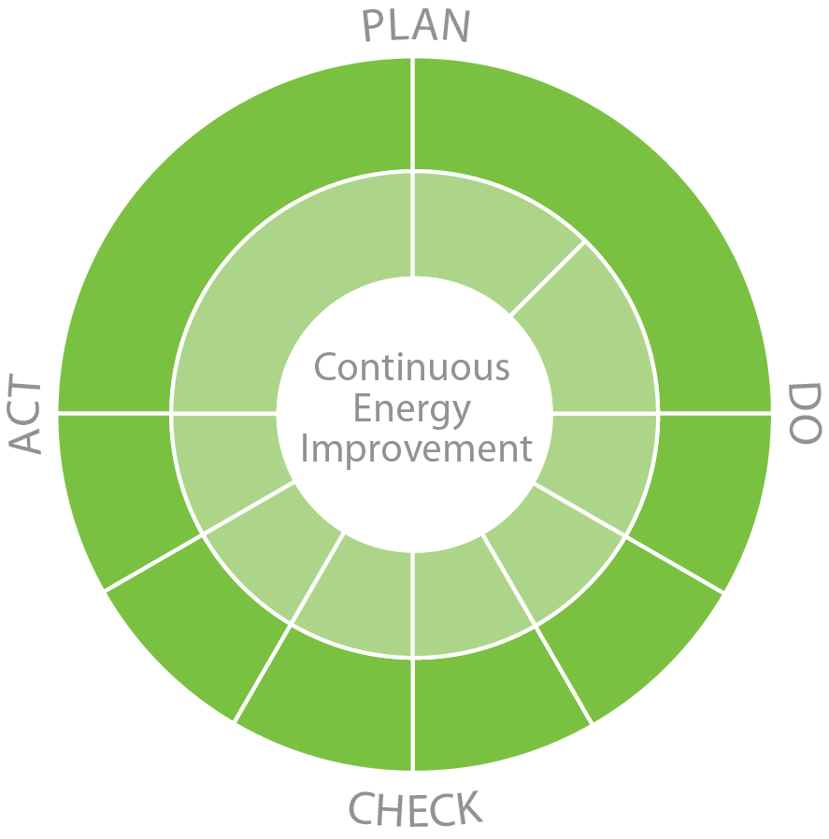
Plan Do Check Act Cycle
Form an energy policy
Set and achieve goals
Create awareness & support
Get and record data
Form an energy team
Perform an energy audit
Find help or hire pro’s
Choose performance indicators
Monitor, target, & report
Translate data into performance
Estimate costs
Choose best energy projects
Improve through O & M
Notes:
Instructions:
This slide is animated. Take a minute after opening this slide to watch the animation.
Talking Points:
Continuous Energy Improvement is a cycle: This is an image that shows how we will make an energy plan, execute it, check our performance, and then tweak our plan to make it better and better. The different activities are clustered around different parts of the PDCA cycle.
CEI helps change the way we think about energy to permanently integrate that change into our company’s culture. We’re going to use CEI to:
Raise awareness of energy as a waste stream.
Understand how our daily decisions impact energy use.

Slide 25
Getting to our Goal
Support from leadership
A written energy policy that includes:
[Add details here]
Endorsed cross-functional energy team
[Add details here]
Notes:
Instructions:
Fill in the blanks/details on this slide before presenting.
Review the facility-specific details you added to each bullet with your audience.
CEI works across four key areas in a company to create a systematic approach to continuous improvement: Organizational Structure, People, Manufacturing Systems, and Measurement.
Talking Points:
The items on this slide help us meet our goals by addressing Organizational Structure.

Slide 26
Getting to our Goal
Awareness and training
[Add details here]
Maintanence and operations
[Add details here]
Notes:
Instructions:
Fill in the blanks on this slide before presenting.
Review the facility-specific details you added to each bullet with your audience.
CEI works across four key areas in a company to create a systematic approach to continuous improvement: Organizational Structure, People, Manufacturing Systems, and Measurement.
Talking Points:
The items on this slide help us meet our goals by addressing People.
This presentation is part of awareness and training, which will be important for our ongoing success. Overcoming old habits and creating new ones is a big part of saving energy through simple behavior changes. It’s a lot cheaper than capital investment and it works. But it depends on each of us seeing our company through “energy colored glasses.”

Slide 27
Getting to our Goal
Review of facility performance
and opportunities
[Add details here]
Notes:
Instructions:
Fill in the blanks on this slide before presenting
Review the facility-specific details you added to each bullet with your audience.
CEI works across four key areas in a company to create a systematic approach to continuous improvement: Organizational Structure, People, Manufacturing Systems, and Measurement.
Talking Points:
The items on this slide help us meet our goals by addressing Manufacturing Systems.
By optimizing our equipment and processes we can see tangible improvements to productivity, quality, and of course, energy use.

Slide 28
Getting to our Goal
Reporting, feedback, control systems
[Add details here]
Notes:
Instructions:
Fill in the blanks on this slide before presenting.
Review the facility-specific details you added to each bullet with your audience.
CEI works across four key areas in a company to create a systematic approach to continuous improvement: Organizational Structure, People, Manufacturing Systems, and Measurement.
Talking Points:
The items on this slide help us meet our goals by addressing Measurement. We’ll capture our pre-CEI energy profile in a baseline and continue to document and improve our performance.

Slide 29
Getting & Staying Energy Smart
Led by our energy champion
Supported by our energy team
Involves energy assessments, employee feedback, and training
Supported by our local utility
[energy champion photo goes here]
[energy team photo goes here]
[utility logo goes here]
Notes:
Instructions:
Customize this slide with photos, names and other details before presenting.
Talking Points:
Talk about your energy team.
Compliment these individuals and give them credit for their attitude and extra effort.

Slide 30
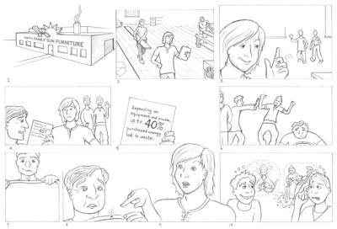
Tools We Use
Notes:
Talking Points:
CEI’s awareness and training materials come with some tools that you may have already seen around: posters and a story that captures some of the main tenets of energy management posted along with our energy stats, and items like these toolbox talk cards.

Slide 31
Staying on Track: The 4th Question
?
Did we have any accidents?
Did we spill anything?
How much product did we make?
How much energy did we use to get it done?
Notes:
Instructions:
CEI will move energy awareness to a similar priority for our company as safety, compliance and productivity.
Talking Points:
Each week in our facility, we ask questions to make sure that production is on track and our employees are working safely and productively. Along with these important questions, we should ask ourselves, “How much energy did we use this month?”

Slide 32
Quiz to Close!
Here’s one more chance to test your energy trivia smarts . . .
Q: What is the cost of the United States’ energy use per minute?
A: The United States uses nearly a million dollars worth each minute, 24 hours a day, every day of the year.
Q: Which uses more energy, a hand razor or an electric razor?
A: A hand razor at a sink (because of the water power, the water pump, and so on)
Q: What percentage of household energy do appliances use?
A: Appliances use about 20% of a typical household’s energy.
Notes:
Instructions: NOTE SPECIAL FORMAT
The first time you hit the advance key, or click your mouse, a question will appear.
When you hit the advance key again, or click your mouse again, the answer will appear.
Repeat to view the next question and answer sets.
Talking Points:
OPTIONAL: OK – here’s one last chance to earn prizes. (Offer a prize to anyone with the right answer to the following questions…)

Slide 33
Thank You
Notes:
Thank you!
Instructions:
This is your closing slide. Thank participants for their time and let them know where they can go in your facility for more information about NEEA’s CEI System and energy efficiency.

